Slide 1

Design Patterns
LESSON 2
BEHAVIORAL PATTERNS

Slide 2
Classification
Creational patterns provide various object creation mechanisms, which increase flexibility and reuse of existing code.
Singleton, Factory Method, Abstract Factory, Builder, Prototype
Structural patterns explain how to assemble objects and classes into larger structures while keeping these structures flexible and efficient.
Adapter, Bridge, Composite, Decorator, Façade, Flyweight, Proxy
Behavioral patterns handle how objects interact: communication, dependencies, isolation.
Chain of responsibility, Command, Iterator, Mediator, Memento, Observer, State, Strategy, Template Method, Visitor
Creational Patterns
Structural Patterns
Behavioral Patterns
Notes:
Creational = mecanisme de creare a obiectele pentru a oferi flexibilitate si reutilizare a codului
Structural = asamblarea obiectelor si a claselor, integrarea lor structuri mai largi, lasand totusi flexibilitate. Aici o sa fie mai grele exemplele, pentru ca nu o sa lucram pe structuri largi
Behavioral = se refera mai mult la algoritmi si asignarea responsabilitatilor intre obiecte

Slide 3
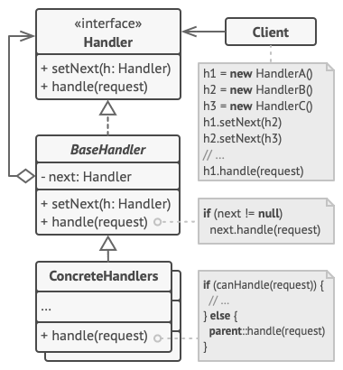
Chain of responsibility
Problem: sequential logic that needs to be executes in a particular logic, a lot of guard conditions (if something, then stop execution)
Solution: transform separate logic to handler objects, each handler in the chain can pass further to another handler, can stop the execution or can process the request

Slide 4
Chain of responsibility in a few words + examples from open-source projects
Unique handlers, each handler knows about its successor
Can become difficult if it’s a long chain of handlers, you can have performance issues
Hierarchical structure, but a handler is not aware of the whole hierarchy, it just knows the next handler
There might be the risk of leaving a request unprocessed
.NET: HTTP pipeline, Microsoft.Practices.EnterpriseLibrary.Logging.Logger
Spring Security filter chain
java.util.logging.Logger#log()
javax.servlet.Filter#doFilter()
NodeJS: express middlewares https://expressjs.com/en/guide/using-middleware.html

Slide 5
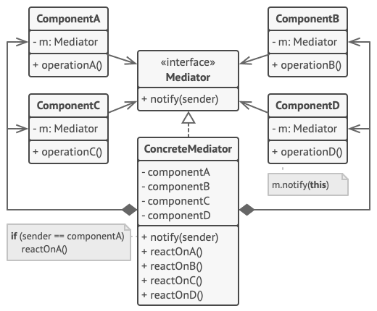
Mediator
Problem:
Solution:

Slide 6
Mediator in a few words + examples from open-source projects
TODO
TODO
TODO
TODO
C#: System.Threading.Timer
Java:
scheduleXXX() methods of java.util.Timer
scheduleXXX() methods of java.util.concurrent.ScheduledExecutorService
java.lang.reflect.Method#invoke()
Mediator.js: https://www.npmjs.com/package/mediator-js

